Slide 1
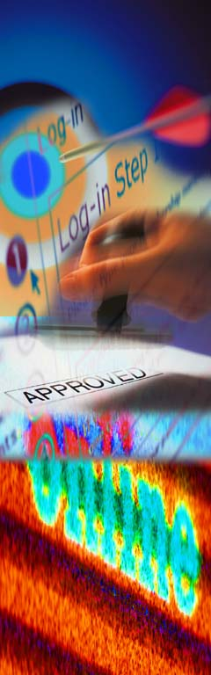




  The 2005 CAS RATEMAKING SEMINAR
COMMERCIAL PROPERTY TERRORISM PRICING
GEORGE BURGER

Slide 2
Terrorism Loss costs
Topics
(1) Loss Costs - International
    Original (2002)
    Revised (2004)
(2) TRIA
    Highlights of Law
    Calculation of Federal Backstop Factors
    Possible Extension
(3) Loss Costs - Domestic

Slide 3
Terrorism Rating
Overview
Line of Insurance | Product | Derivation
Commercial Property | Loss Cost | AIR Model + ISO Adjustment
General Liability Commercial Auto | Percentage Loadings To Current Loss Costs | ISO Modeling
Business Owners | Combination of Property and GL
Other Lines (e.g. CIM, Farm) | Refer to Company

Slide 4
Terrorism Rating
Commercial Property
AIR Results
City/County | Rank | Loss Costs (Bldgs. & Cont.)
Manhattan | 1 | $.173
Chicago | 4 | .068
Seattle | 8 | .010
Marin County | 36 | .001

Slide 5
Terrorism Rating
Commercial Property
Geographic Tiers
Tier | Cities/Counties | Approx. Loss Costs
High Hazard | NYC, Chicago, SF, DC | $.100
Medium Hazard | LA, Boston, Houston, Phil., Seattle | .010
Low Hazard | Remainder of USA | .001

Slide 6
Commercial Property
Adjustments to AIR Loss Costs
Insurance – to – Value
  Divide by .80
Nuclear/Bio-Chemical
  Multiply by 2.00
Federal Backstop Factor
  Insurer Retained Losses ÷ Total Terrorism Losses
Loss Adjustment Expenses
  Add 5% of Adjusted Losses
  No Backstop Adjustment

Slide 7
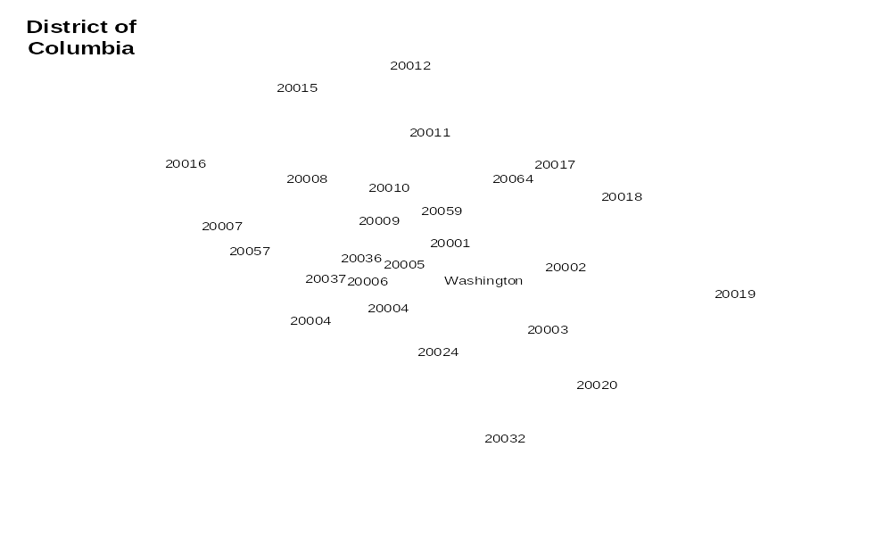
WASHINGTON, D.C.
IMPLEMENTED TERRORISM LOSS COSTS
Tier
1
2
3

Slide 8
2004 REVIEW OF TERRORISM LOSS COSTS
CHANGES TO AIR MODEL
1. Revisions to Conventional Loss Estimates
  Relatively small overall effect (10% reduction)
  Larger Impact in certain zips/counties
2. Nuclear, Biological and Chemical (NBC) Loss Estimates
  Refined treatment estimates NBC losses on the same geographic basis as conventional losses.
  Replaces the prior estimate which assumed NBC=Conventional
  Compresses Loss Costs Within Large Metropolitan Areas i.e. smaller loss costs in center city, higher loss costs in outlying counties.

Slide 9
AIR INTERNATIONAL TERRORISM MODEL
COMMERCIAL PROPERTY
Comparison of Annual Expected Losses
 | 2002 AIR Version | 2004 AIR Version
Conventional | $1.45 Billion | $1.30 Billion
NBC | $1.45 Billion* | .95 Billion
Total | $2.90 Billion | $2.25 Billion
* Preliminary Estimate

Slide 10
CERTIFIED TERRORISM LOSS COSTS
SAMPLE IMPACTS OF AIR VERSION 2.0
ORIGINAL LOSS COSTS NEW LOSS COSTS
Location |  | Conventional |  | NBC | Combined |  | Conventional | NBC | Combined
DOWNTOWN |  | $.100 |  | $.100 | $.200 |  | $.090 | $.020 | $.110
OUTLYING AREA |  | .001 |  | .001 | .002 |  | .001 | .015 | .016

Slide 11
Terrorism Loss Costs
Distribution of Conventional vs. NBC
Original Loss Costs | New Loss Costs
Location | Conventional % | NBC % | Conventional % | NBC %
Chicago | 50% | 50% | 85% | 15%
Lake Co., ILL. | 50 | 50 | 3 | 97
San Francisco | 50 | 50 | 95 | 5
Marin Co., Cal. | 50 | 50 | 1 | 99
Houston | 50 | 50 | 55 | 45

Slide 12
REVISED TERRORISM LOSS COSTS
NEW GEOGRAPHIC TIER DEFINITIONS
Tier (a) | Nature | Definition (b) | Approximate #
1 | By Zip | Loss Costs = $.10 | ~ 40 Zips contained in 4 cities
2 | By City/County (c) | $.01 < Loss Costs < $. 04 | ~ 80
3 | By County (C) | Loss Cost < $.01 | ~ 70 with loss cost = $.005 remainder = $.001
(a) “Tiers” still have relevance for the purpose of backstop factor application.
(b) Loss costs are unadjusted for backstop.
(c) There are about 3200 counties in the US.

Slide 13
Terrorism Risk Insurance Act
Key Features
Lines of Insurance
    Property Casualty Only
    Commercial Lines Only
    Excludes Medical Malpractice & Miscellaneous
Duration
    3 Years (Through 2005)
    2005 Declared “Mandatory”
    “Hard” Landing of Policies at Expiration of TRIA
Structure of Federal Backstop
    Deductible: Insurers Pay 100% Under Deductible
    (Increases from 7% to 15% of prior year’s total Premium)
    Coinsurance: Insurers pay 10% Above Deductible
    Annual Cap: No Coverage Above $100 billion

Slide 14
Federal Backstop Pricing
Modeling Assumptions
Annual Expected Terrorism Losses (All lines) = $3.2 Billion
  Commercial Property (AIR Model) = $2.25 Billion
  Inclusion of Business Interruption & LAE = + $.60 Billion
  Exclusion of Alternative Markets & Rejected Coverage = $-1.25 Billion
  Factor to Include All Other Lines = 2.0
99th Percentile Point = $50 Billion
Insurer Proportions of Loss:
(1) Losses Slightly Disproportionate to Premiums
(2) Losses Very Disproportionate to Premiums

Slide 15
Certified Terrorism
Federal Backstop Factors
Tier | TRIA Year 2 (2004) | TRIA Year 3 (2005)
1 (High Hazard) | .60 | .75
2 (Medium Hazard) | .80 | .90
3 (Low Hazard) | .90 | .95

Slide 16
CONGRESSIONAL PROPOSAL
TO
EXTEND TRIA
Two-Year Extension (thru 2007)
“Soft” Landing of Policies into 2008
All Current LOB’s + Group Life
Insurer Deductible Continues @ 15%

Slide 17
Commercial Property
Domestic Terrorism
Comparison of Annual Expected Losses based on AIR’s Terrorism Model
 | 2004 Domestic | 2004 International
Conventional | $155M | $1.30 Billion
NBC | 65M | .95 Billion
Total | $220M | $2.25 Billion
* Domestic as a percentage of International = 10%

Slide 18
Domestic Terrorism
Loss Costs Strategy
– Approach: % Loadings to Base Loss Costs
    No separate rating structure
    Implementation as part of normal review/filing process
– Two Tier Breakdown:
  High Hazard: + 1% (NYC, SF, DC, Chicago, Boston)
  Remainder of U.S.: + 0.5%
– Conservative Loss Cost Selections
    Model-Based Indications for Events > $25 Million
    Avoids Redundancy with Ratemaking Data Base
– Will be implemented for Commercial Property and BOP only

